Slide 1

VIS Program
Insights
2020 Year-end Edition
Analysis Range: July 2020 – Dec 2020
1

Slide 2



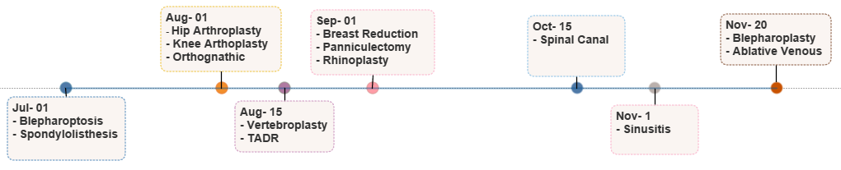
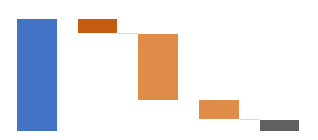
Executive Summary
14 Use Cases
Implemented
Achieved 2020
Pipeline
~25 Use Cases in pipeline
Target 2021
* Basis current visibility
Document Summary
Decision Concordance
Provider Adherence
Image/Text Availability
Case Review Staff Processing
Since Jul-2020, VIS has processed 44,976 cases with 33% image/text availability
~77% (31,027) of total cases (40,154) without attachments or relevant images/text attached are approved by case review staff
Hip Arthroplasty, Knee Arthroplasty and Spinal Canal are top 3 use cases where case review staff approvals are highest without relevant attachments or images/texts
The drivers behind low image availability are MBM managed use cases such as Spondylolisthesis, Spinal Canal, TADR and Vertebroplasty have lowest Image availability
3,333 providers are contributing to 25% of total case volume while 0% image/text availability is observed
59% of cases decisioned by VIS didn’t meet the objective criteria for approval.
94% of VIS Not approved cases were approved by Nurses
730 providers with high image/text availability (>80%) have 0% augmentation
Use Case Deployment Timeline
Performance Summary
LOB Type
Processing Type
5,885
E&I - 39,634
Image - 42,028
4,263 (11%)
3,328 (8%)
44,976
26,262
C&S - 5,342
Text - 2,948
8,007
559 (11%)
1,494 (51%)
No Attachment Found
No Text / Image Identified
Substandard Text / Images
4,822
Augmentation % with respect to Total Cases
Total Cases
Successful Augmentation
2

Slide 3

Image/Text Availability – Key Drivers
This section provides details on the image/text availability status for the deployed use cases and key drivers of the same.
Total Cases vs Image / Text Availability - MBM & Non MBM
MBM
Non MBM
Nov-20 vs Dec-20
Image/Text Availability
Image/Text Availability – Monthly comparison
Decrease in image/text availability
Increase in image/text availability
Key Highlights!
Image availability is high for Non MBM use cases as compared to MBM use cases
High text availability is observed for OCR based use case Ablative Venous (94%)
Image availability is highest for Blepharoptosis (95%) and lowest for Vertebroplasty and TADR (5%)
Out of 14 deployed use cases Image / text availability has improved for 4 use cases in Dec’20
MBM use cases have low Image availability and low successful augmentation (0% - 5%)
Low augmentation is observed for majority of the Non-MBM use cases as well. Substandard quality images are major factor contributing to the same
Highest augmentation is observed for OCR based use case Ablative Venous (63%)
3

Slide 4
Image/Text Availability – Provider Deep Dive
This section focuses on the provider behavior to identify key drivers of low image/text availability for deployed use cases.
*below analysis is on Referring Providers
Key Highlights
3,333 Referring Providers have submitted clinical attachments without any images/text
Improvement with better images/text quality from these 3,333 providers could lead to significant improvement in the overall augmentation rates
548 Providers have image/text availability between 1% to 30% and contribute to 33% of the total cases processed by VIS
1,738 providers have image/text availability > 80%, however 730 of these providers submit images/text that can’t be augmented
Improved reception of images/text attachments from these 730 providers for Breast Reduction & Ablative Venous use cases could help improve the overall augmentation
Analysis of providers with high image/text availability but varying successful augmentation (result of substandard image/text quality)
Enterprise Data & Analytics
4

Slide 5



Case Review Staff Decisions – Policy Adherence
This section showcases the trends observed in iCUE approvals post Case review staff processing while consuming different quality of images/text.
 | No Attachment Found | No Images/Text Identified | Substandard Images/Text | Successful Augmentation
Total Cases | 5,885 | 26,262 | 8,007 | 4,822
iCUE Approved | 3,736 (63%) | 20,846 (79%) | 6,445 (80%) | 3,501 (73%)
iCUE Approvals - Use Case Drill Down
Use case drill-down views of iCUE Approvals based on no attachment found, no images/text identified and substandard images/text, not adhering to the policy guidelines for case review staff
No Attachment Found | No Images/Text Identified | Substandard Images/Text
Key Highlights
~77% (31,027) of total cases (40,154) without attachment or relevant images/text attached are approved by case review staff
High case review staff approvals (~80% approvals) are observed where case attachment doesn't have an image/text associated or the image/text doesn't meet the policy criteria
Hip Arthroplasty, Knee Arthroplasty and Spinal Canal are top 3 use cases where case review staff approvals are highest
5

Slide 6
Case Review Staff Decisions – Decision Concordance
The primary objective of this section is to highlight the decision concordance between VIS and Case review staff decisions. The section covers all deployed use cases where VIS decision making criteria available.
VIS Decision Summary
VIS Decisioned Cases
VIS Approved
VIS Not Approved
3,607
1,481 (41%)
2,126 (59%)
VIS vs iCUE Decision
 |  | VIS Approved | VIS Not Approved
MD | Approved | 371 (71%) | 510 (54%)
 | Not Approved | 150 (29%) | 430 (46%)
Nurse | Approved | 794 (92%) | 996 (94%)
 | Not Approved | 65 (8%) | 61 (6%)
Key Highlights
Of 3,607 cases augmented by VIS, 59% are categorized as Not Approved basis the objective criteria
~93% of total cases were decisioned by Nurses and MDs
94% of “VIS Not Approved” cases were “Approved” by Nurses while only 54% of the same is approved by MDs
Recommend audit of Ablative Venous (528 cases) and Breast Reduction cases (183 cases) to understand usage of VIS in decision making and to determine the performance of algorithm

Slide 7
End of the presentation
Thank you
Enterprise Data & Analytics
7

